Slide 1


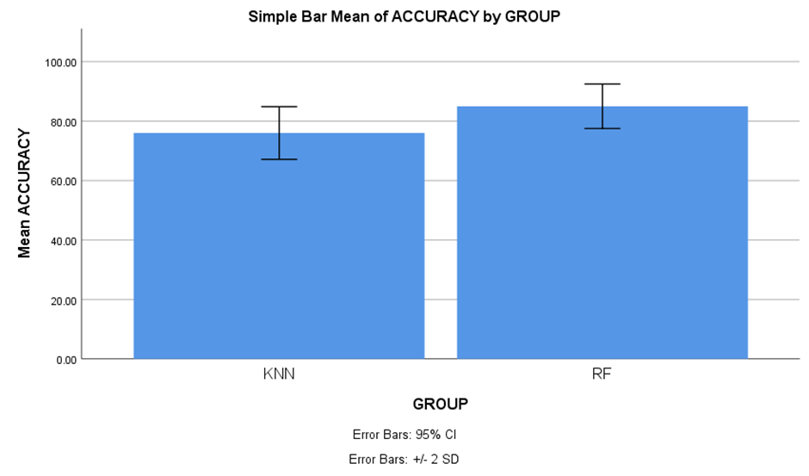
Name: B. Hemanth Chowdary Register Number: 192210391
Guided by Dr. Nelson Kennedy Babu C
Ms. Poorani.S
Guided by Dr. Mary Valantina. G
Insurance Cold Calling Optimization Using Random Forest Regression Compared With
K - Nearest Neighbours For Improved Accuracy
INTRODUCTION
The primary aim of this research is to optimize the cold-calling process for insurance companies, focusing on improving efficiency, reducing resource consumption, and enhancing overall productivity.
By refining cold-calling strategies, insurance companies can more effectively attract new customers and maximize profits
To identify factors like call timing, audience demographics, and communication skills that affect cold-calling success and to evaluate the effectiveness of various machine learning techniques, such as Random Forest Regression and K-Nearest Neighbours (KNN), in streamlining marketing and sales initiatives for insurance companies
Use machine learning algorithms, such as Random Forest Regression and K-Nearest Neighbours (KNN), to analyze and optimize cold-calling strategies
Enhanced sales outcomes for insurance companies, with higher conversion rates and increased customer satisfaction, resulting from more targeted and data-driven cold-calling methods
Fig 1. Steps for mastering Cold Calling
MATERIALS AND METHODS
Split Data into Training and Testing Sets
The Data was collected from Kaggle
The data has been preprocessed and performed various techniques like Data cleaning, feature engineering
The data has been split into two different datasets (i.e. Training set – 75% and Testing set – 25%)
Then, performed model evaluation and model validation using Random Forest regression and K – Nearest Neighbours
Data Collection / preprocessing
Feature Engineering
Model Training (Random Forest Regression)
Performance Comparison of Decision Tree and Random Forest for Walmart sales
Model Evaluation (MAE, MSE, RMSE)
Process of evaluating and optimizing Insurance Cold Calling
RESULTS
Table 1. The Mean Accuracy of the Random Forest Regression algorithm and the K-Nearest Neighbours.
 | Group | N | mean | Std. Deviation | Std. Error mean
Accuracy | Random Forest Regression | 10 | 85.4000 | 3.74166 | 1.18322
 | K – Nearest Neighbours | 10 | 74.5000 | 4.42217 | 1.39841
The figure shows the mean accuracy of the Random Forest Regression is greater than the K-Nearest Neighbours algorithm. X axis is Random Forest Regression vs K-Nearest Neighbours , Y axis is Mean Accuracy. Error bar is +/-2 SD
Fig 2. The Mean Accuracy Graph
DISCUSSION AND CONCLUSION
Random Forest Regression outperformed K-Nearest Neighbours (KNN) algorithm in optimizing insurance cold calls, achieving an average accuracy of 85.4% compared to 74.5%
Statistical comparisons between Random Forest Regression and KNN algorithms included mean accuracy, standard deviation, and mean standard error, with Random Forest Regression exhibiting superior performance
Independent sample tests further supported the superiority of Random Forest Regression over KNN, with a significance level indicating the reliability of the results
The findings align with previous studies, highlighting the effectiveness of Random Forest Regression in sequential data processing tasks, particularly in the context of optimizing cold-calling procedures
Random Forest Regression's strengths are well-suited for the procedural nature of the cold calling domain, whereas KNN algorithm may struggle with capturing complex temporal relationships in insurance cold calling data
BIBLIOGRAPHY
Bartram, Söhnke M., Jürgen Branke, and Mehrshad Motahari. 2020. Artificial Intelligence in Asset Management. CFA Institute Research Foundation. DOI: 10.2139/ssrn.3510343
Buuren, Stef van. 2018. Flexible Imputation of Missing Data, Second Edition. CRC Press. DOI: 10.1201/9780429492259
Denuit, Michel, Donatien Hainaut, and Julien Trufin. 2021. Effective Statistical Learning Methods for Actuaries I: GLMs and Extensions. Springer Nature. DOI: 10.1007/978-3-030-25827-6
Filippi, Alexandru, Justin Aurelian, and Maria-Magdalena Mocanu. 2024. “Analysis of the Gene Networks and Pathways Correlated with Tissue Differentiation in Prostate Cancer.” International Journal of Molecular Sciences 25 (7). DOI: 10.3390/ijms25073626
Gearheart, James. 2020. End-to-End Data Science with SAS: A Hands-On Programming Guide. SAS Institute. DOI: 10.1111/insr.12423

